Slide 1


An overview of Microsoft SharePoint and current use cases for Seaboard Corporation
Eric Howerton
Senior Business Analyst, Corporate IT
Seaboard Corporation
August 2014

Slide 2
SharePoint Overview

Slide 3
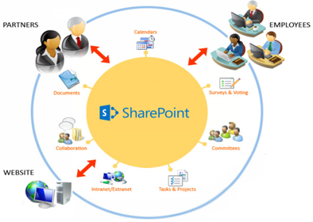
Overview of SharePoint
What is SharePoint?
Microsoft SharePoint is a front-end web application with a back-end SQL database
Primary Uses
Online document storage
Collaboration and sharing
Rapid website deployments
Workflow creation for automated processes
Process/item tracking

Slide 4
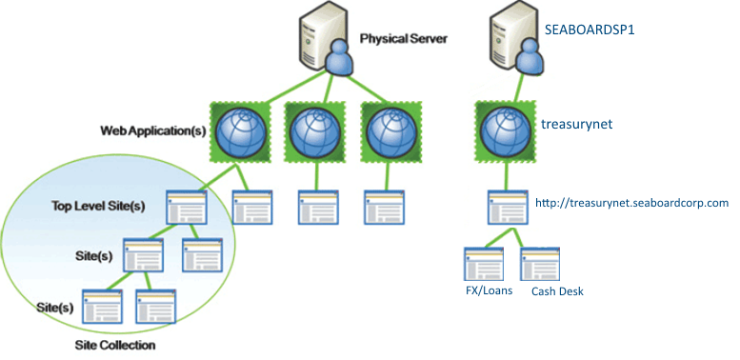
Web Applications (websites)
Microsoft SharePoint allows us to create new Web Applications and Top-Level websites within those web applications quickly and easily.
Websites can even have sub-sites that are useful for specific projects or processes that can be created without IT assistance.
Example
Seaboard Finance TreasuryNet
Parent site “treasurynet”
Numerous subsites (~20)
FX/Loans
Cash Desk
Managed by Finance department

Slide 5
SharePoint Best Practices
What We’ve Learned
Map out your SharePoint architecture/structure for site collections and sub-sites before you build
Having a Change Management process in place for your critical SharePoint apps can help to identify risk areas
Train your business owners on SharePoint so they can make most changes themselves, without asking IT for help
Cautions and Considerations
Try to avoid 3rd party applications that alter your Master Page
Sites with personal identifiable information (PII) need to have compliance steps put into place
Externally published sites need to go through a threat management server with encryption to avoid network breach
Solutions involving SOX processes will need appropriate oversight and documentation

Slide 6
SharePoint Solutions and Examples
Online document storage
Collaboration and sharing
Rapid website deployments
Workflow creation for automated processes
Process/item tracking

Slide 7
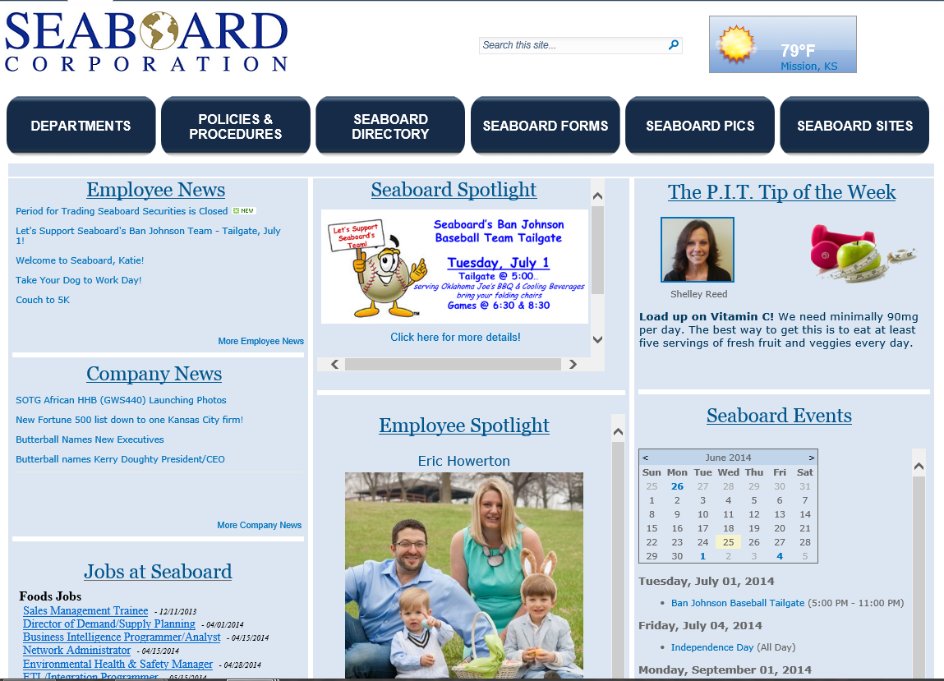
Company Intranet
The Seaboard Corporate Intranet was redesigned in SharePoint 2010 – users can access policies and procedures, online forms, and see specific content by department. Homepage is non-static and is updated often to increase traffic.
Primary Uses
Online document storage
Collaboration
Sharing
Website (Intranet)
Workflow and process automation
Notes:
This is the homepage of our Corporate Intranet – built in SharePoint 2010 with minor adjustments to CSS/branding for the look and feel of the site. Content is organized into sections (Departments, Policies and Procedures, Forms, etc.) for ease of access by users.

Slide 8
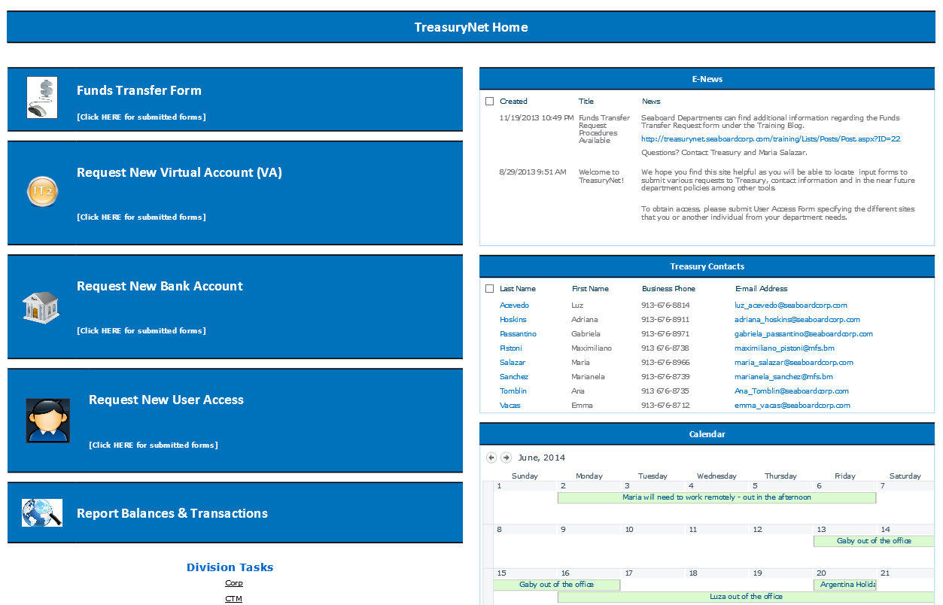
External Financial Portal
Users both internal and external (including banking institutions) can use this SharePoint solution to transfer funds, request wire transfers, bank accounts, virtual accounts, and automated loans. This portal is actually comprised of many different subsites
Primary Uses
Online document storage
Sharing
Workflow and process automation
Notes:
This is the homepage of our Corporate Intranet – built in SharePoint 2010 with minor adjustments to CSS/branding for the look and feel of the site. Content is organized into sections (Departments, Policies and Procedures, Forms, etc.) for ease of access by users.

Slide 9
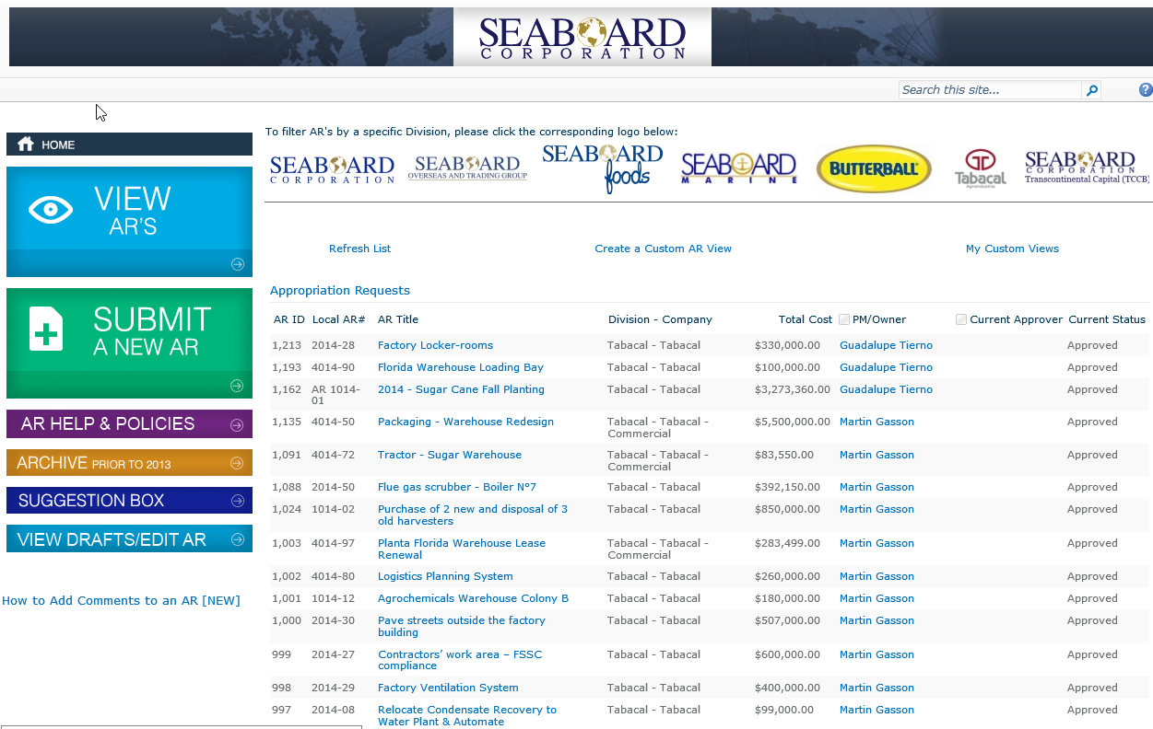
Appropriation Requests
The AR web application is a way for divisions to request capital purchases that require both local and Corporate approval. The AR system tracks approvals, houses documents, has a commenting and approval history section, and allows for filtered views by division, cost, and approval status.
Primary Uses
Collaboration
Workflow and process automation
Process/Item tracking
Notes:
This is the homepage of our Corporate Intranet – built in SharePoint 2010 with minor adjustments to CSS/branding for the look and feel of the site. Content is organized into sections (Departments, Policies and Procedures, Forms, etc.) for ease of access by users.

Slide 10
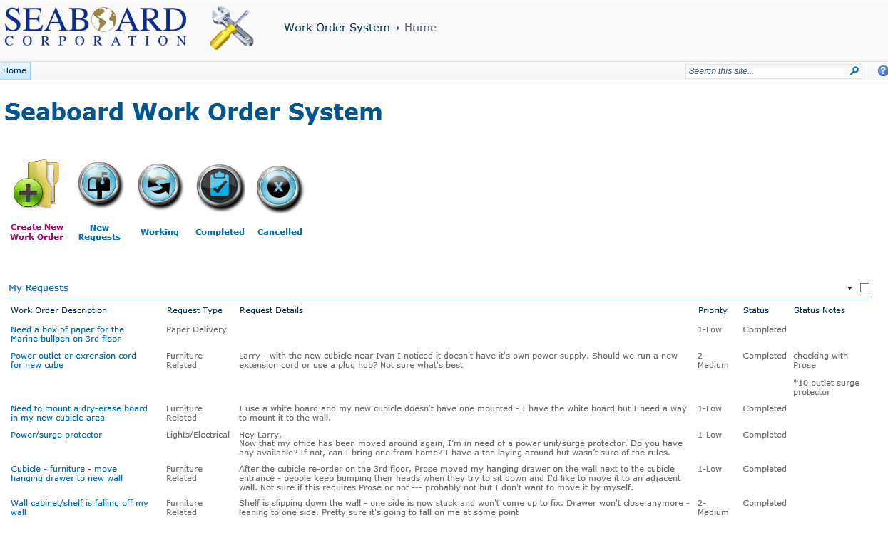
Building Maintenance (Work Orders)
Users can create new building work orders using an online form which utilizes a workflow to send notifications to the maintenance team. Users can track the status of their request online to see when their requests have been completed.
Primary Uses
Workflow and process automation
Process/item tracking
Notes:
This is the homepage of our Corporate Intranet – built in SharePoint 2010 with minor adjustments to CSS/branding for the look and feel of the site. Content is organized into sections (Departments, Policies and Procedures, Forms, etc.) for ease of access by users.

Slide 11
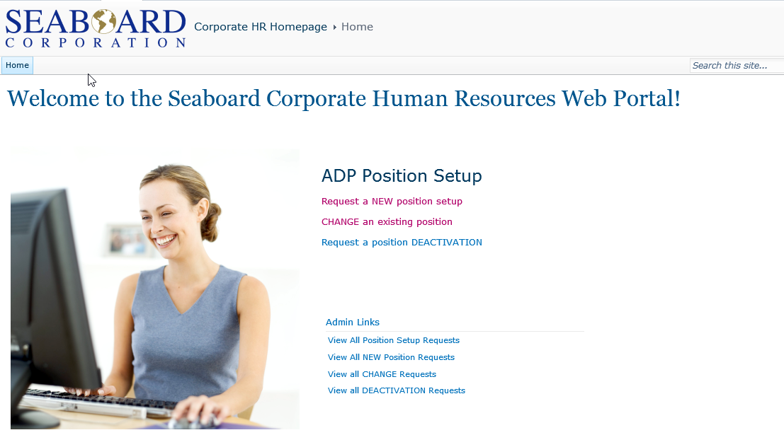
Human Resources
HR managers can send new positions to be set up in ADP payroll services using online forms and workflows for approvals. Requests can be moderated by HR, with unique permissions and views.
Primary Uses
Online document storage
Collaboration
Workflow and process automation
Notes:
This is the homepage of our Corporate Intranet – built in SharePoint 2010 with minor adjustments to CSS/branding for the look and feel of the site. Content is organized into sections (Departments, Policies and Procedures, Forms, etc.) for ease of access by users.

Slide 12
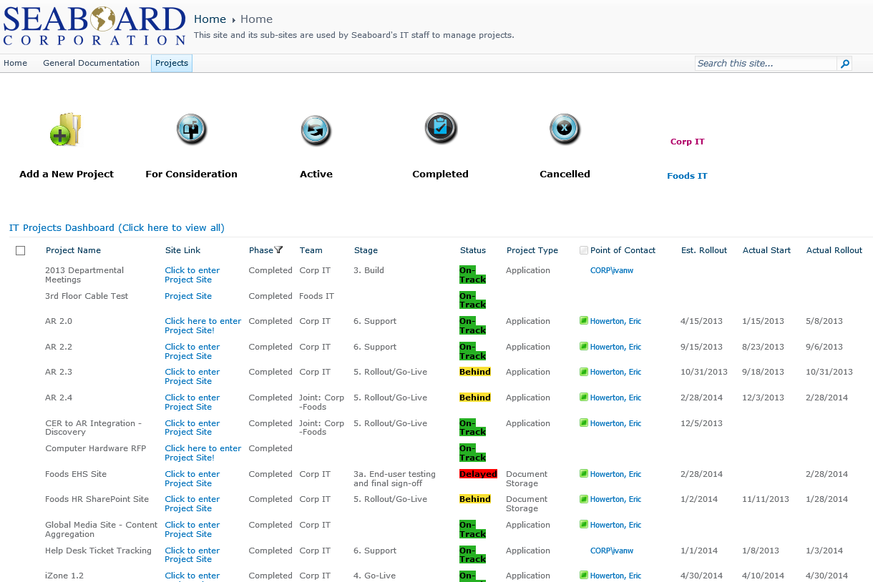
Project Management – Master Project Dashboard
This is an example of a Project Tracker in SharePoint. A main list (dashboard) shows the status of all projects and some key information about each. You’ll notice that each project also has a “Click to Enter Project Site” link – each project also has it’s own subsite to manage project documents, issue tracking, requirements, and timeline.
Primary Uses
Online document storage
Collaboration
Website (Project sites)
Workflow and process automation
Process/item tracking
Notes:
This is the homepage of our Corporate Intranet – built in SharePoint 2010 with minor adjustments to CSS/branding for the look and feel of the site. Content is organized into sections (Departments, Policies and Procedures, Forms, etc.) for ease of access by users.

Slide 13
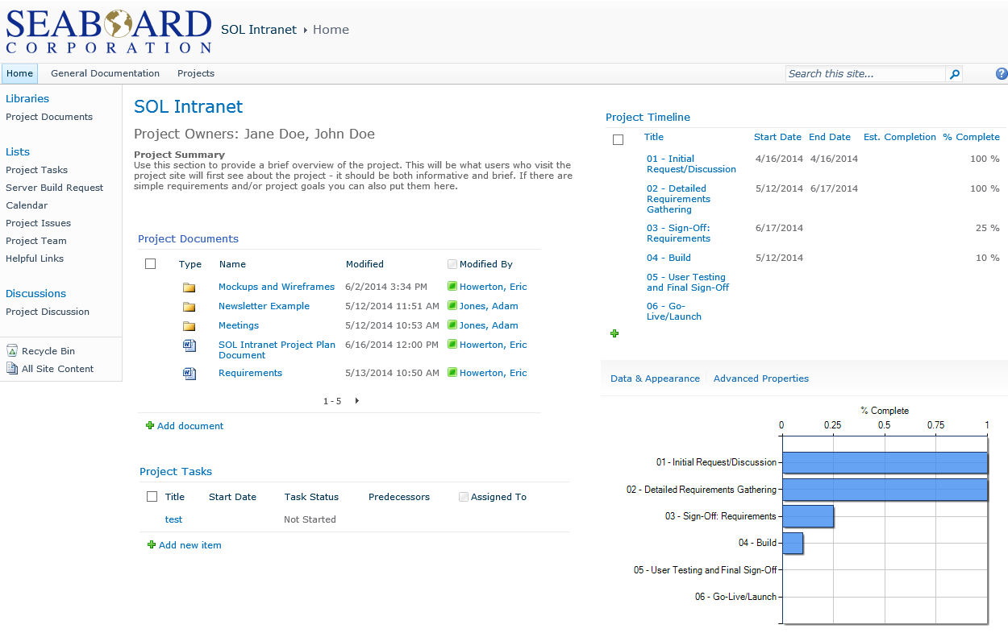
Project Management – Project Site
Example of a project sub-site from the main Project Dashboard.
Primary Uses
Online document storage
Collaboration
Sharing
Workflow and process automation
Notes:
This is the homepage of our Corporate Intranet – built in SharePoint 2010 with minor adjustments to CSS/branding for the look and feel of the site. Content is organized into sections (Departments, Policies and Procedures, Forms, etc.) for ease of access by users.

Slide 14
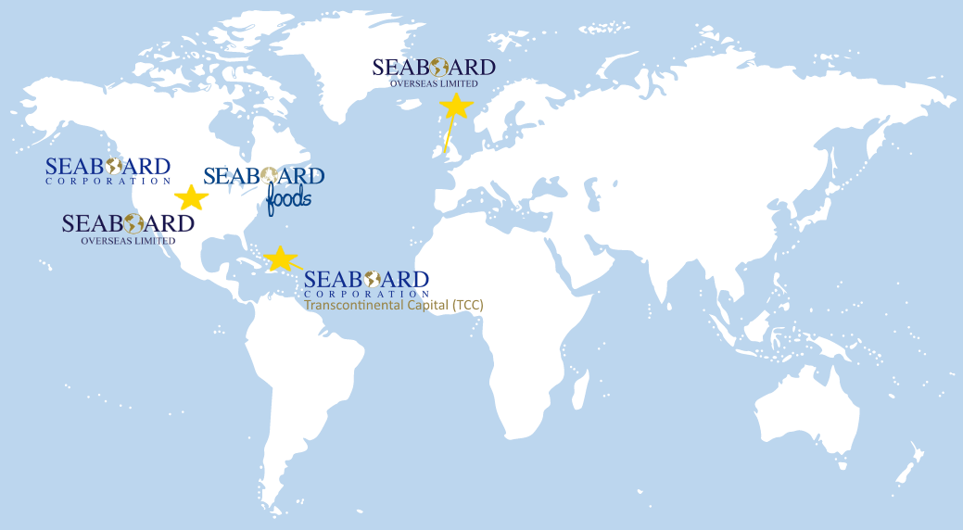
Corporate IT: Here to Help
Ivan Winfield Corporate Director of IT ivan_winfield@seaboardcorp.com 913-676-8852 | Eric Howerton Senior Business Analyst eric_howerton@seaboardcorp.com 913-676-8721 | Adam Jones Business Analyst 14 adam_jones@seaboardcorp.com 913-676-8747

